Slide 1
Inclusion & Psychological SAFETY
IMLA Diversity & Inclusion Group - Lunch & Learn Session
Baljit Singh
Notes:
Happy International Women’s Day everyone. The theme is #breakingthebias. I would like to spend some time in exploring what psychological safety is, what does it look like, what does it feel like when it’s not present and fundamentally what do we need to put in place in order for colleagues to bring their full selves to work.

Slide 2
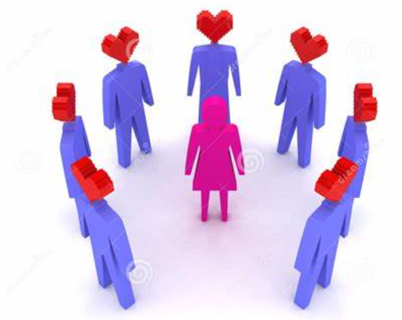
Where did psychological safety come from…
Dr. Amy Edmondson, a Harvard Business School professor coined the term psychological safety. She defined it as the following:
"a belief that one will not be punished or humiliated for speaking up with ideas, questions, concerns or mistakes."
Notes:
A truly safe environment where you can be your true self

Slide 3
What is PSYCHOLOGICAL SAFETY?
Psychological safety is a condition in which human beings feel:
Included – this is the basic human need to connect and feel a sense of belonging
Stage 1. INCLUDED
Safe to learn – this is the basic human need to learn and grow
Stage 2.
LEARN
Safe to contribute – this is the basic human need to contribute and make a difference
Stage 3. CONTRIBUTE
Safe to challenge – this is the basic human need to make things better
Stage 4. CHALLENGE
The 4 stages of Psychological Safety by Timothy R. Clarke
Notes:
Let’s have a look at what that means when we break down that feeling of being able to ask questions, share a different perspective. Timothy R Clarke talks about psychological safety in 4 stages. /.
Stage 1. Is the first stage of psychological safety. It Is a feeling of being included – the basic need to connect and feel like you belong. If we think about a work environment this is joining a new team and it’s your first day. It’s really important to begin to start connecting and getting a sense of belonging. Those weeks and months are quite crucial in helping to building on that sense of belonging and connection. Then we move on to stage 2. where you are at a stage where you start to learn and grow but can only do that by asking those questions. Then when you feel safe to do so you begin to contribute and move to the 3rd stage of psychological safety.
Stage 3. Is feeling safe to contribute- basic human need to contribute , using our skills and abilities to make a difference to the value- creation process. At this stage you really begin to start performing as a colleague but could not have got to this point without having gone through stages 1&2.
Stage 4. Feeling like you are safe enough to start challenging without fear of being embarrassed or marginlised in any way. The team and environment allows you to feel safe enough to challenge. This is when you can offer an opposing view but not feel that you will be punished for it.

Slide 4

What does psychological safety mean in the workplace
Freedom to share your thoughts and opinions
Being able to express your concerns even if you are the only one in the room expressing those concerns
Being able to allocate tasks and give coaching as and when needed and not for it to be taken in the wrong way
A safe space where colleagues feel a sense of ease and fully supported
Given the space to take measured risks after considering possible scenarios
Notes:
So if we bring all that theory together, then this is what it can look like. It’s about having the freedom to share, express your concerns
Also, allocate tasks and give feedback without it being taken the wrong way. Your intentions are seen as well meaning.
It also means you feel fully supported and your manager has got your back
You are given the space to grown, take measured risks and if things don’t work out then you learn from that and move on and no one will think bad of you or that you have failed.

Slide 5
How does it make you feel when you have psychological safety...
Notes:
Safe, warm , valued, trusted

Slide 6
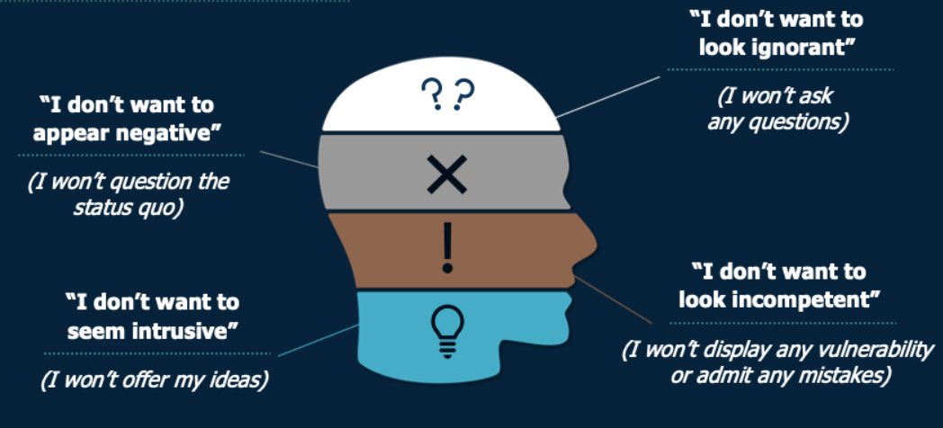
What does a lack of psychological safety look like in the workplace
Notes:
When you don’t feel some of those things mentioned previously there is a certain level of anxiety around some of the thoughts you may have ie.
I don’t want to look ignorant so that stops you from not asking any questions but through your questions it could spark a great idea in someone else's head
Equally, I don’t want look incompetent so therefore not show any vulnerability or admit any mistakes. I feel scared/ anxious of the repercussions of that.
Similarly, I don’t want to seem intrusive which signals that the environment is not conducive to offering any new ideas or even upsetting the status quo. How disappointing is that and you can quite quickly see that as colleagues/ teams we don’t really move forward.
Imagine joining such a team….it will be difficult for you to stay in that team and you can quite quickly see how easily anxiety and stress can rear it’s ugly head.

Slide 7
How does it make you feel when you don’t have psychological safety…
Notes:
Anxious, ignored, not valued, depressed

Slide 8
What are the colleague benefits of psychological safety in the work place
1. Inclusion Safety
3. Contribution Safety
Valued
Treated fairly and without bias
Appreciated
Feel like you belong
Engage in an unconstrained way
Have open dialogue
Look for new opportunities
Foster constructive debates
2. Learner Safety
Psychological Safety
4. Challenge Safety
Innovate
Learn and grow
Experiment
Not afraid
Challenge the status quo
Feel safe to speak up
Identify changes
Expose problems
Notes:
When we have psychological safety the benefits to colleagues are untold. So, when we start a new role we should be looking to feel valued, treated fairly and without bias. No favourites in the team. You should feel appreciated and that you belong there. After a bit, you should be given the space to experiment with out fear, the space to learn and grow. As time goes on, you will feel comfortable to have open, frank conversations and again not be afraid, It’s opportunity to contribute your ideas and look for new opportunities. This is about fostering can environment that is open to constructive debate. Finally as we begin to feel more comfortable in our role we are in a position to challenge, speak up and expose any problems/issues

Slide 9
What are the organisational benefits of psychological safety
Decrease in absence
Attract and Retain talent
High Engagement
40-45% of absence is attributable to worry, anxiety, stress and depression
Organisations who create psychologically safe environments will find it easier to attract and retain talent
Where colleagues feel valued and listened to they are more likely to engage better with the organisation
Increased Productivity
Improved reputation for the organisation
Increased Profitability
High engagement of colleagues will lead to increased productivity as colleagues are prepared to go that extra mile
This is as a result of higher performing teams and happy teams. They promote their team and organisation from within
From improved performance, faster delivery, higher quality and better innovation. Reduced absence and colleague turnover

Slide 10
What can I do to create psychological safety
Promote Self Awareness
Show concern for your colleague/team member
Actively solicit questions
A number of organisation are openly sharing
The shocking news of Sarah Everards murder
Update from the latest Women in Finance
Build your self awareness
Understand better your typical responses to changes or challenges
Reflect on what your own biases are
Take a free unconscious bias test: https://implicit.Harvard.edu/implicit
Get into the practice of asking how colleagues are doing
Appreciate a colleagues whole self at work and not just what they deliver
Can help reduce anxiety and stress once that colleague is comfortable to share
As your team/colleague is arriving at a decision – pause to ask for questions/different viewpoints
Count to ten in your mind before moving on -this is to allow colleagues time to formulate their thoughts before voicing them
This avoids the same colleagues stealing the airtime
Notes:
What can you do to help foster the right environment and create a psychological safe environment
Understand yourself better and your responses to changes or challenges. Think about your own biases. We all have them
Show your human side- ask how colleagues are doing. There is more to that colleague then just what they deliver. You want to get the people around you to a stage where they feel comfortable to share who they really are
Ask questions, be mindful of those who steal the airtime, pause and be acessible

Slide 11
What can I do to create psychological safety
Show value and appreciation for ideas
Promote positive dialogue and discussion
Be precise with information, expectations and commitments
A number of organisation are openly sharing
The shocking news of Sarah Everards murder
Update from the latest Women in Finance
Encourage colleagues to share feedback via email/Teams or in person
Be responsive/ open and accessible to colleagues
Inspire open and honest conversations
Cognitive studies have shown that affirmative language can actually motivate you to succeed
E.g. Replace ‘challenge’ with opportunity
Helps employ a positive mindset that empowers colleagues to speak up without fear
Build trust
Be mindful of the information you share, expectations and commitments you set
Be accurate and realistic
Be thoughtful/considerate
Notes:
Show vale and appreciation- create a comfortable environment. Continue to encourage feedback. We never stop learning. Be open and responsive and accessible.
Promote positive dialogue and discussion. Be open and honest. Be positive in the language you use
Finally, build trust, be clear on your expectations , don’t change the goal posts , be accurate and thoughtful

Slide 12
ANY QUESTIONS

Slide 13
THANK YOU FOR LISTENING

